Slide 1
Star Visualizer
Jordan, Ei, Noah

Slide 2
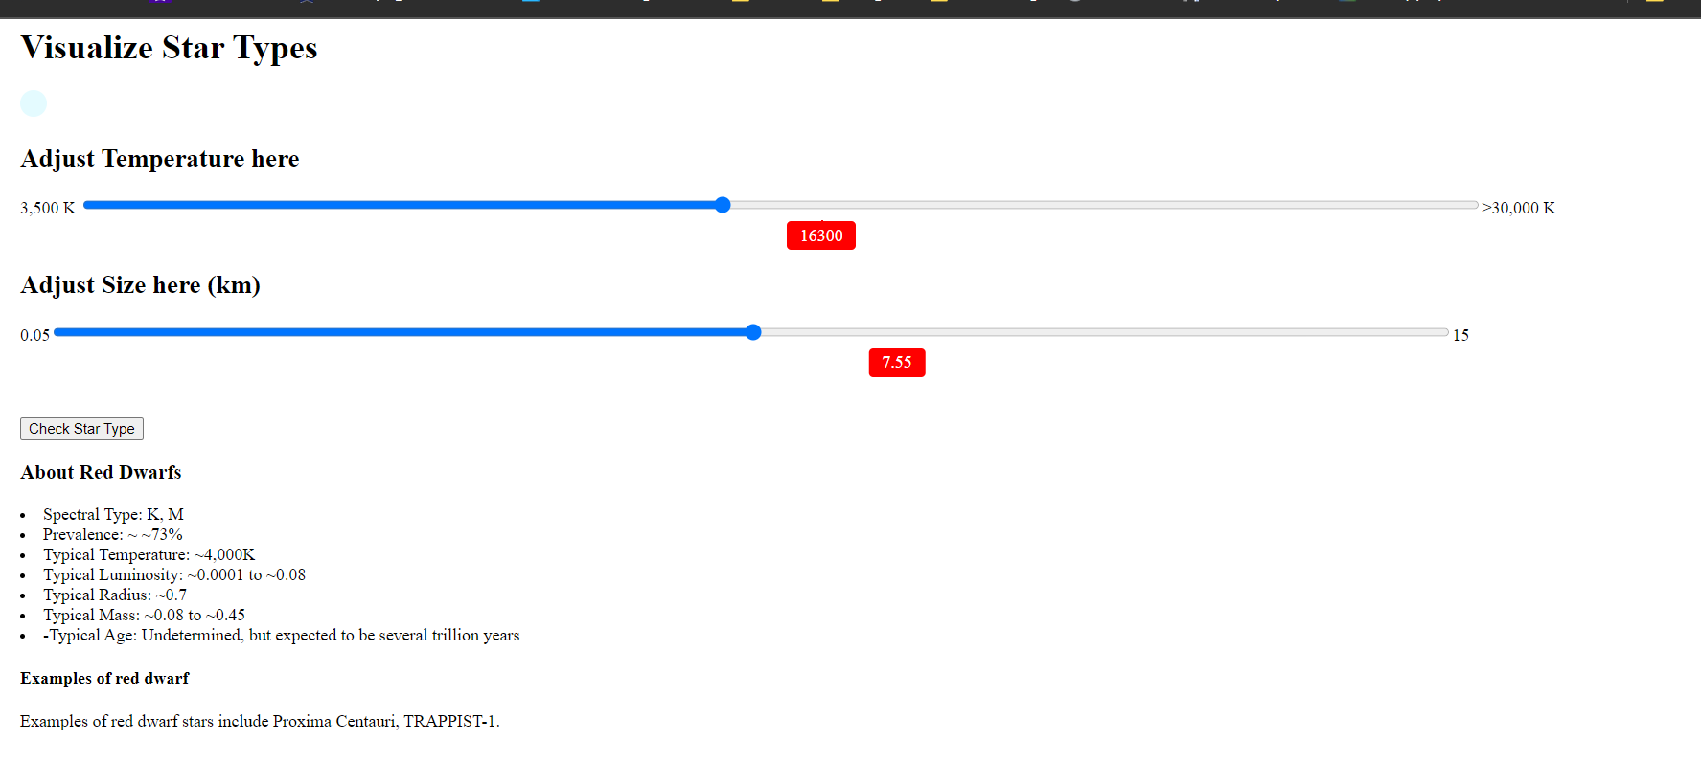
Example of Red star

Slide 3
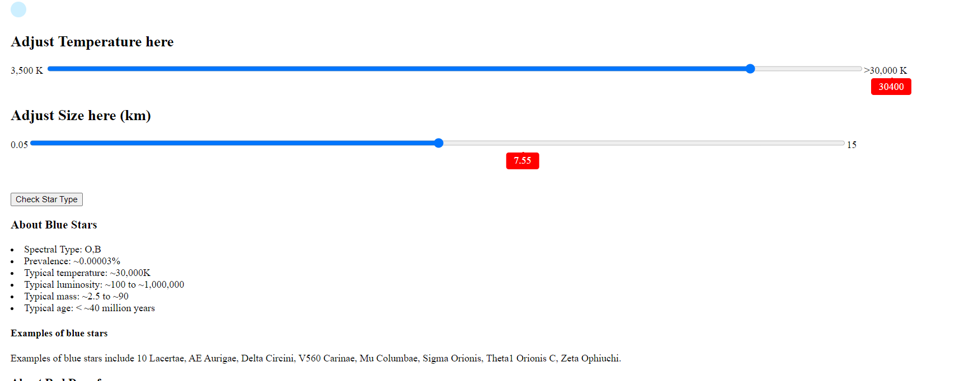
Example of Blue star

Slide 4
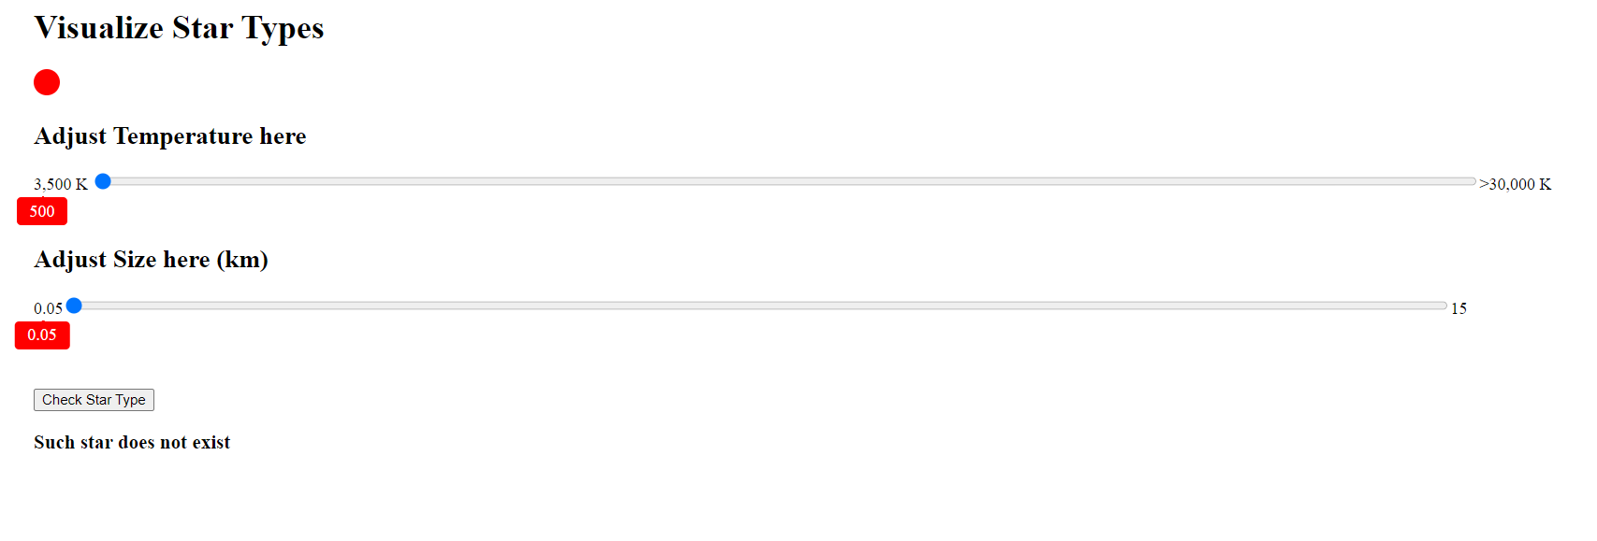
Example of No Star

